Slide 1
Simulation of Inter-VM Data Exchange in Cloud Computing using CloudSim
This presentation from the team "Cloud-Stack Innovators," comprising Akriti Rawat, Manya, and Anshika Saklani, explores the simulation of inter-virtual machine (VM) data exchange using CloudSim. The project addresses key challenges in cloud computing including efficiency, security, and latency in VM communication. Through simulation, the team aims to optimize the performance and resource allocation involved in data sharing between VMs, leveraging CloudSim’s capabilities to model and analyze different data exchange methods.

Slide 2
Problem Statement
Challenges in Inter-VM Communication
Project Objective
Data sharing between virtual machines often faces high latency and security vulnerabilities. Inefficient use of resources complicates this scenario further, hindering effective communication in cloud environments.
This project seeks to simulate inter-VM communication to identify optimal strategies that reduce latency, enhance security, and improve resource allocation for efficient data exchange.

Slide 3
Proposal Overview
Motivation
Current Methods & Limitations
Enhance the efficiency of VM data sharing by minimizing delays and security risks inherent in cloud communication.
Shared storage techniques
Network-based data transfers
Middleware solutions
Challenges: Latency, security flaws, and operational inefficiencies

Slide 4
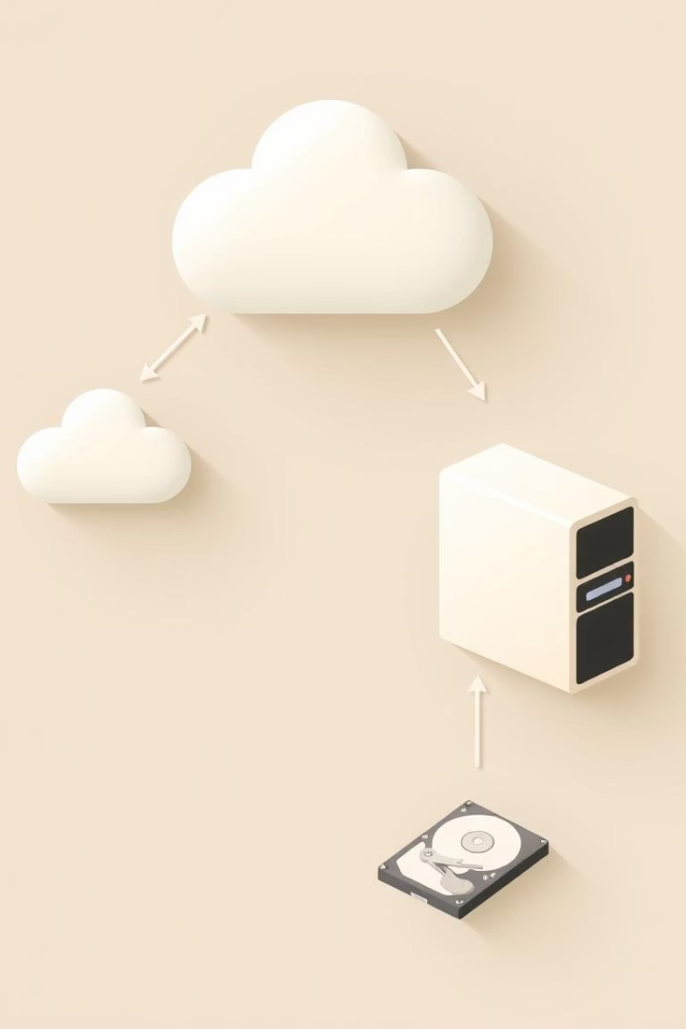
Proposal - Goals and Approach
Project Goals
Implement simulation environment using CloudSim
Create multiple VMs for data sharing
Evaluate different data exchange methods
Methodological Approach
Simulate direct VM communication
Test shared storage models
Analyze network-based transfer
Measure latency, bandwidth, and resource consumption

Slide 5





Phases of the Project
Requirement Gathering
Collect detailed needs and specifications for the simulation tasks.
Design Phase
Architect the simulation framework and VM setups.
Implementation
Develop simulation modules and configure VM interactions.
Testing and Analysis
Execute simulations, collect data, and analyze outcomes.
Documentation
Compile comprehensive reports on methodology and findings.

Slide 6
Work Distribution and Status
Team Member
Responsibilities
Status
Akriti Rawat
CloudSim setup, design implementation
Completed
Manya
Virtual machine creation, data sharing simulation
In Progress
Anshika Saklani
Testing and performance analysis
In Progress

Slide 7
System Architecture
Core Components
VMs and Processes
CloudSim Framework enabling simulation control
VM1 and VM2 configured for data sharing
Datacenter representing cloud infrastructure
Cloudlets representing computational tasks
Cloud Broker managing VM scheduling
Data exchange mechanisms between VMs analyzed

Slide 8

Advantages of Using Simulation
Cost-effective
Flexibility and Scalability
Eliminates the need for costly physical infrastructure while testing diverse scenarios.
Enables simulation of various configurations and large-scale cloud systems effortlessly.
Speed and Safety
Accelerates evaluation processes without risking damage to real systems.

Slide 9
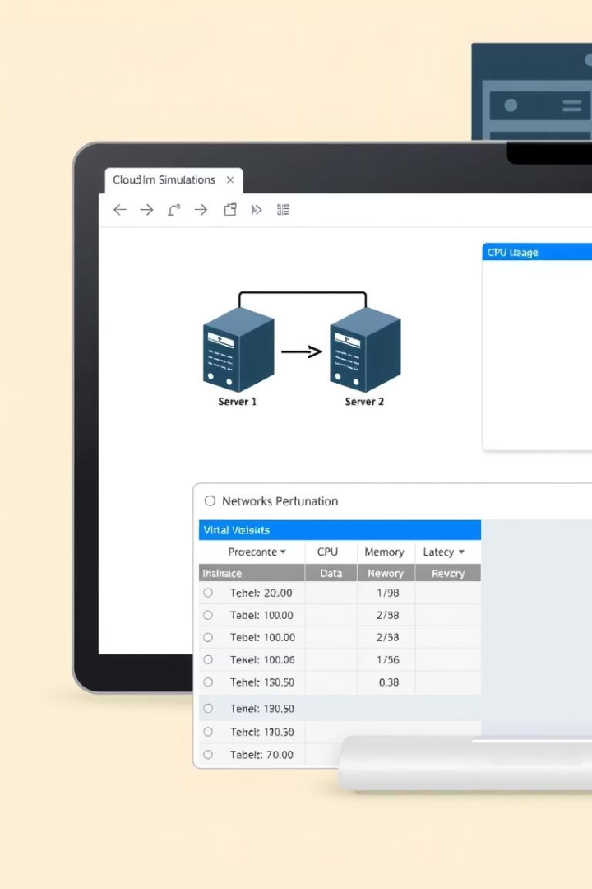
Running Module (Demo)
Current Status
The CloudSim environment has been successfully set up with two virtual machines operational. Basic data exchange frameworks are running, demonstrating the feasibility of the proposed methods.
Next Steps
Extend simulation scenarios to include varied data exchange techniques and conduct detailed performance analysis.

